Slide 2
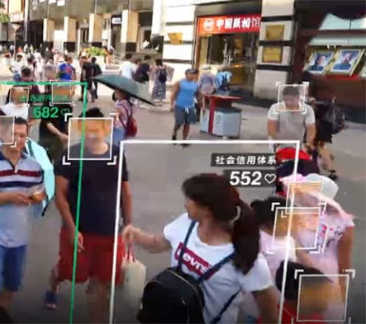
Introduction
This project is motivated by the increase in the usage of face detection.
China → Social Credit System
“it’s a numerical grading system that allows the Chinese government to monitor and control the behavior of its citizens” (Summers 2019).
Positive or negative points leads to sanctions.
OpenCV

Slide 3
Project Overview
Improving the face detection algorithm
Measuring similarity between pictures
Applying filters on faces
Creating a GUI (Graphical User Interface)

Slide 4
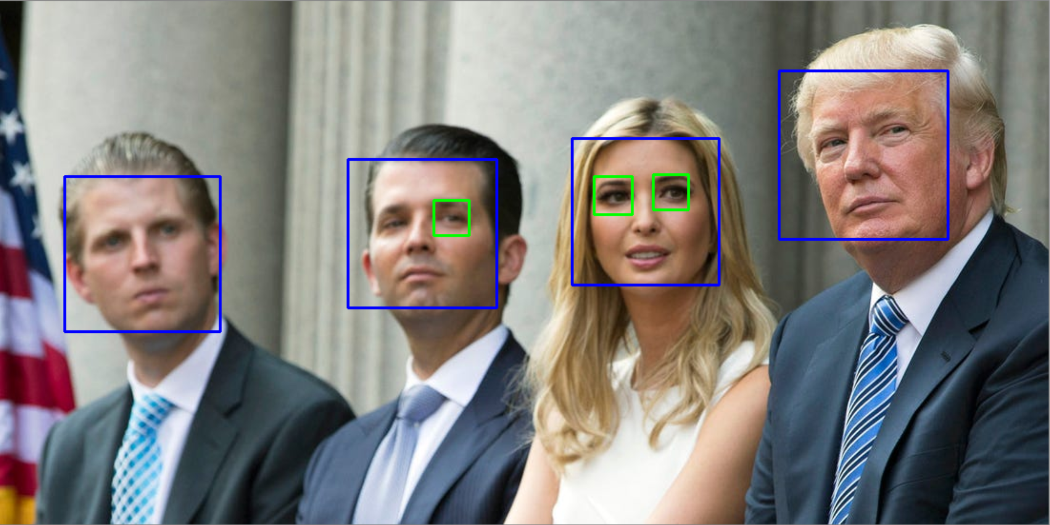
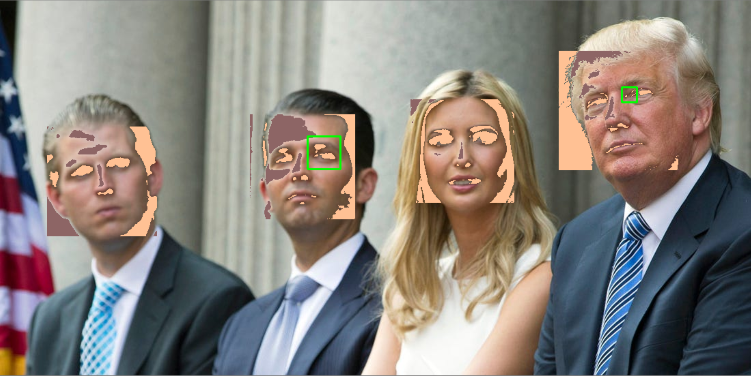
Improving face detection algorithm
Frontal Face Detector and Eye Detector at filtered image
Frontal Face Detector and Eye Detector original image

Slide 5
Lists of references
Summers, Josh (2019): China’s Social Credit System and Froeigner Grading System. https://www.travelchinacheaper.com/china- social-credit-system-explained. Access 15.12.2019.

